Slide 1
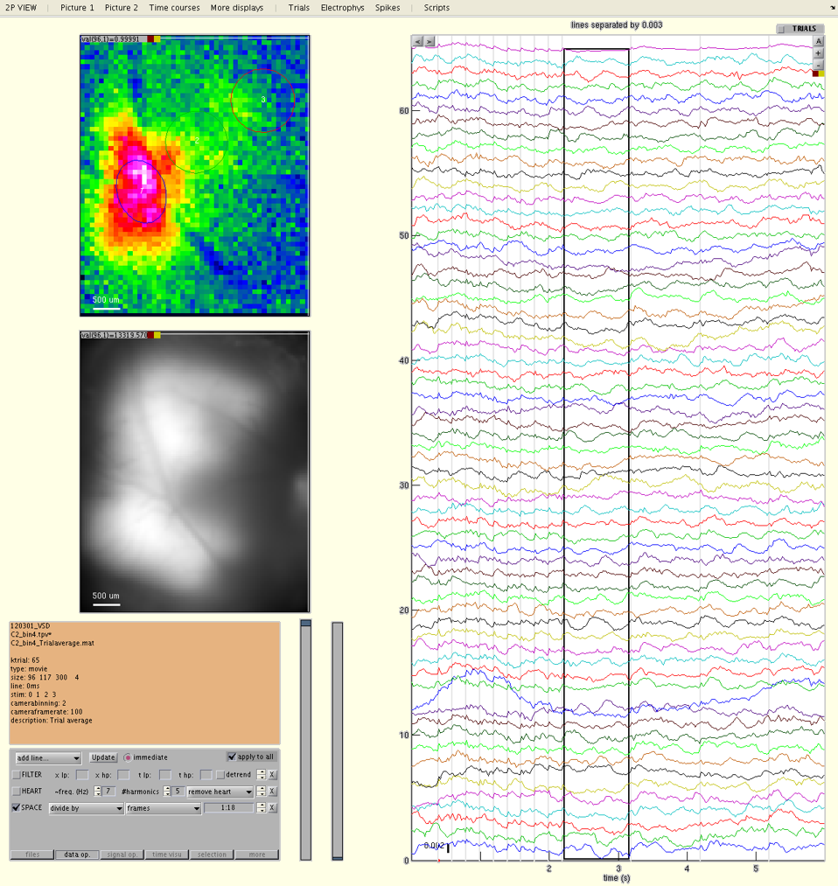
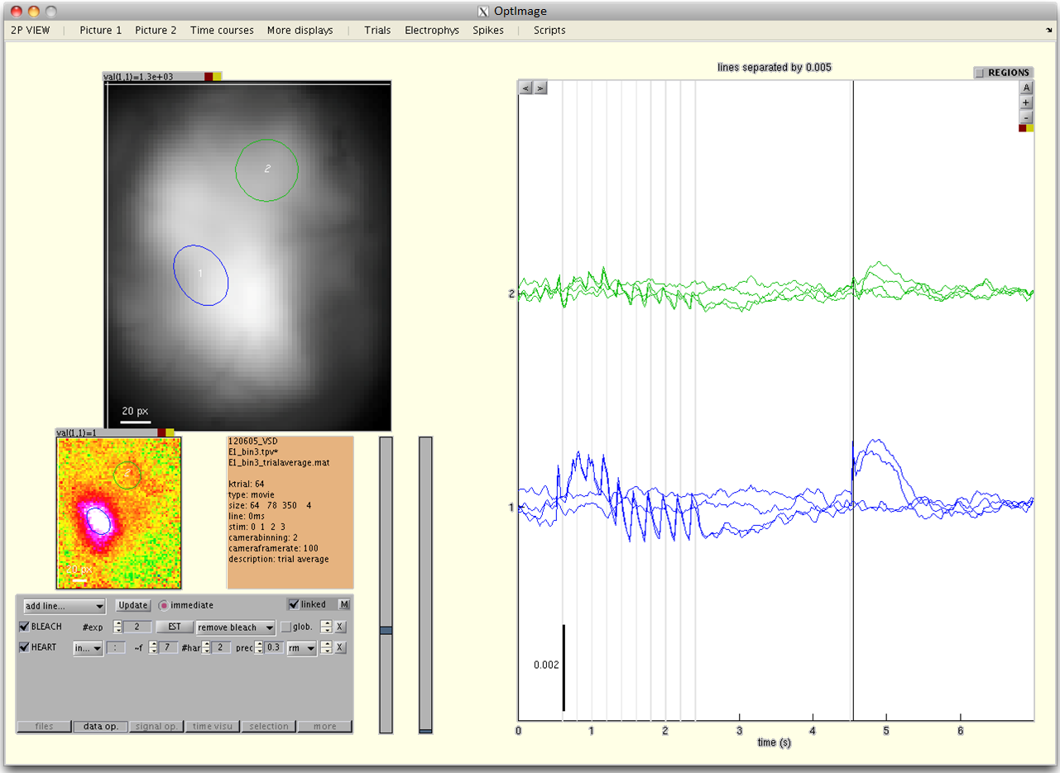
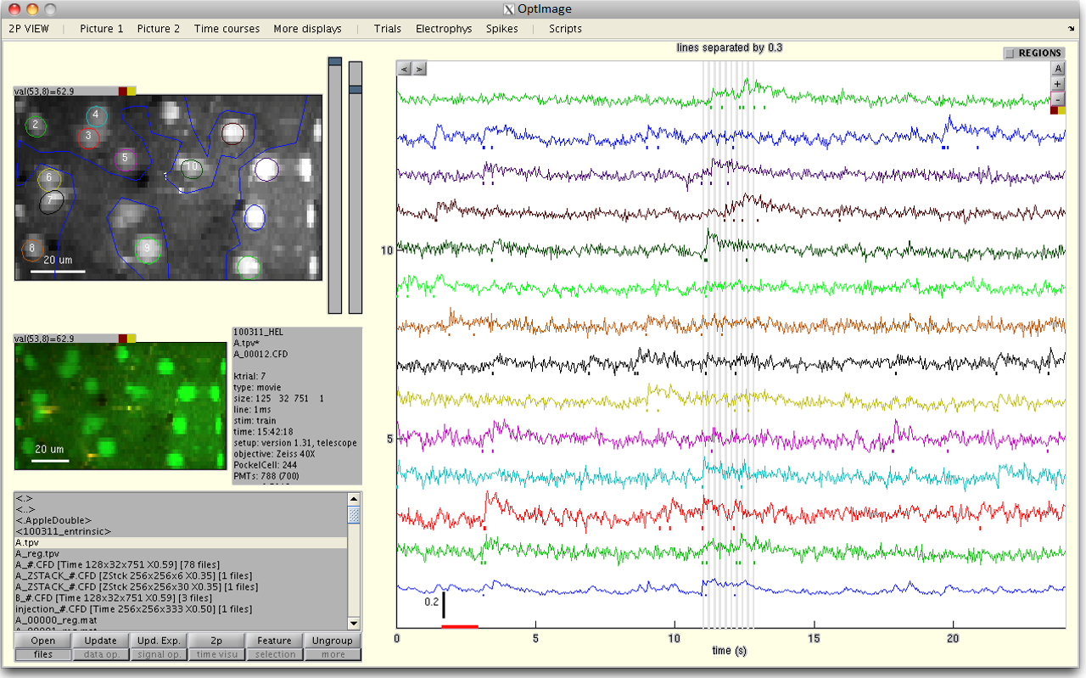
OptImage

Slide 2
Requirements
Matlab 7.14 (R2012a) or later with
Image Toolbox
Optimization toolbox (necessary only for specific functionalities such as the correction for bleaching and for heart artifact)
8GB RAM or more is recommended for analyzing large data

Slide 3
Installation
Unzip the program to a target location
Run the function ‘optimage.m’ in Matlab
Press the button ‘request a license number’ to get an identifier unique to your machine and send it to your provider
Once your provider returned a license number to you, start again the program, press button ‘activate your license’ and copy the number there

Slide 4
I. Quick Tour
Processing the data
Visualizing the data
Other useful tools

Slide 5
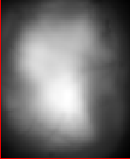
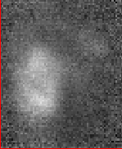
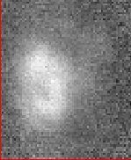
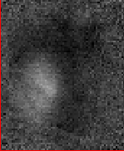
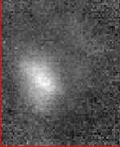
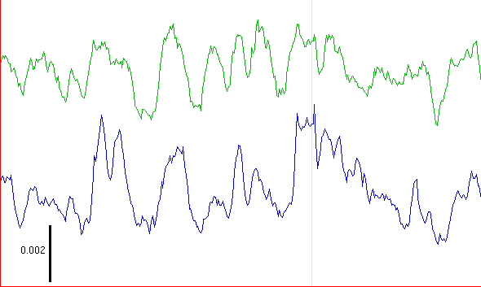
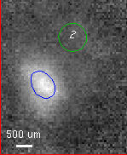
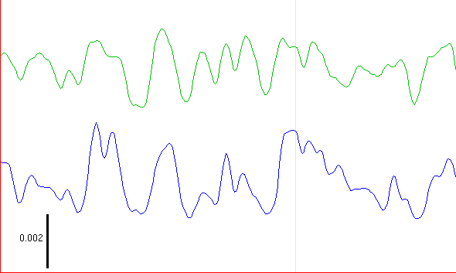
1) Processing the data
Open the data
Header information
Operations on movie data
Extraction of time courses
Operations on time courses
Save
1mm
80ms
STIM

Slide 6
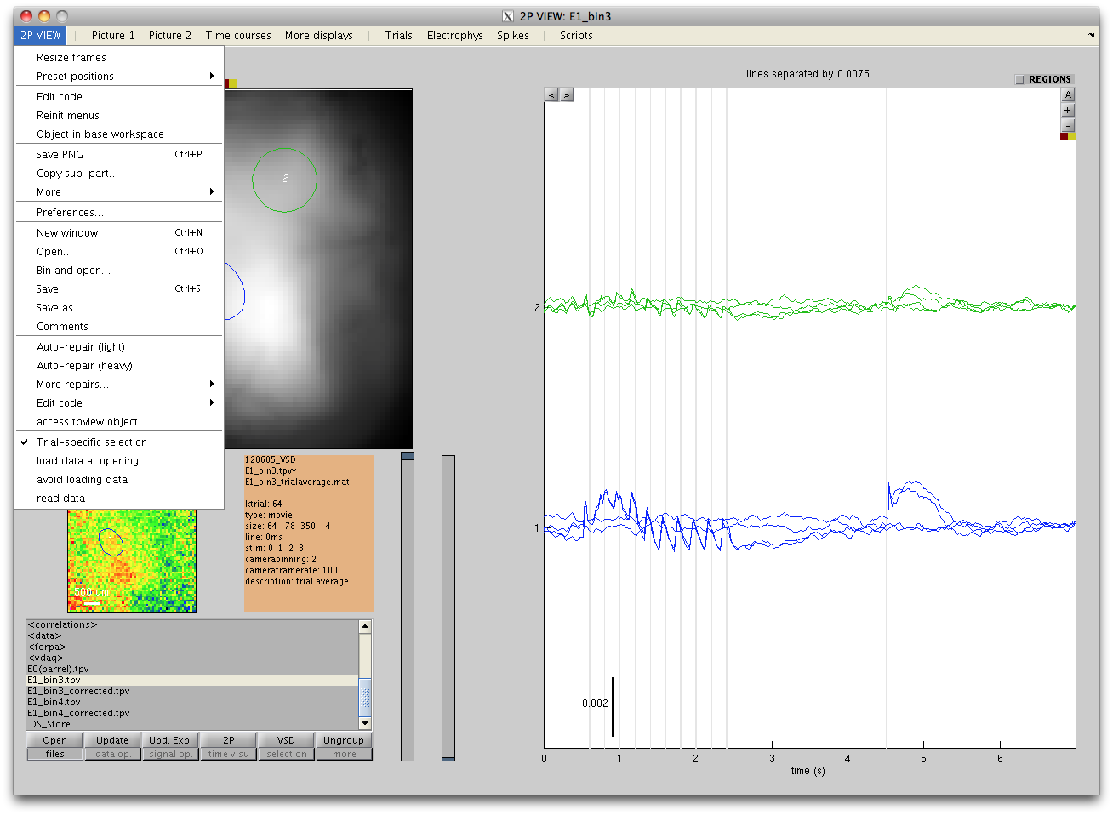
1)a. Open the data
Open from the menu
or use the « files panel »

Slide 7
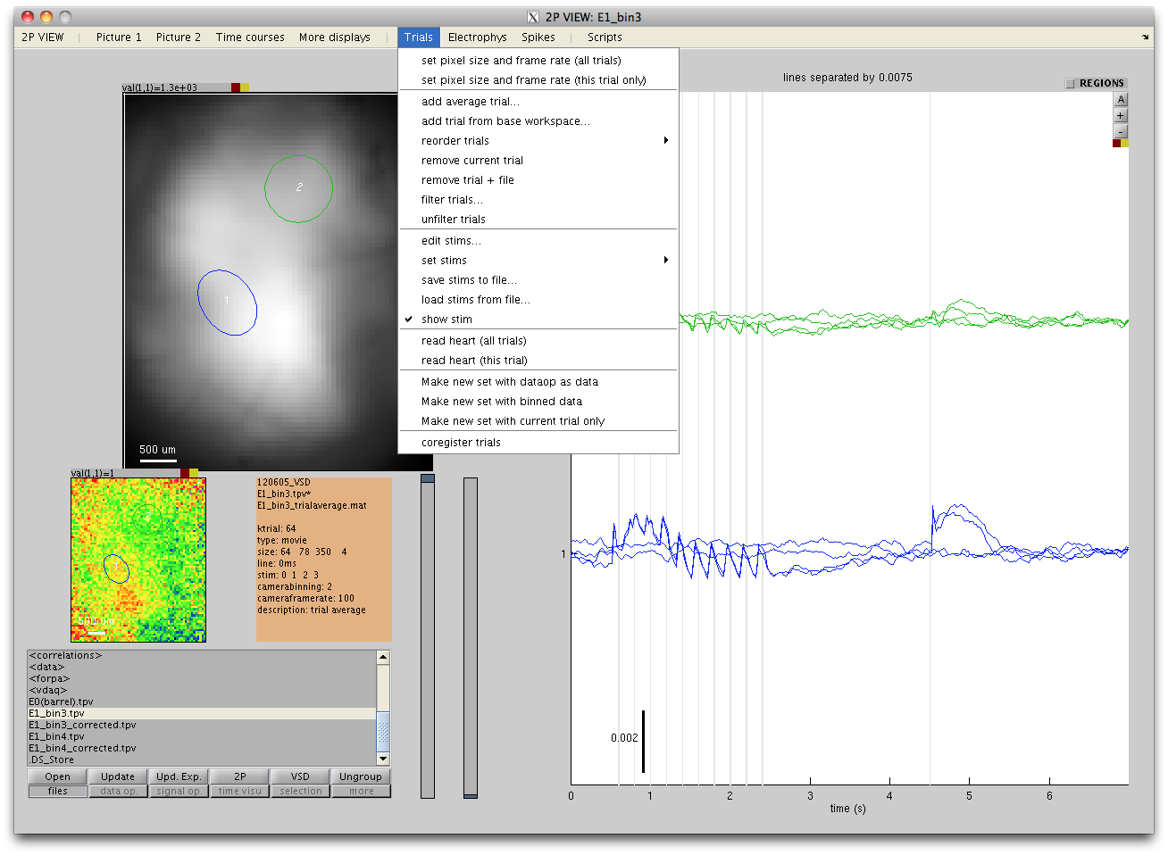
1)b. Header information
Set pixel size and frame rate
Add/remove/reorder/filter trials
Definition of the stimulation sequence

Slide 8
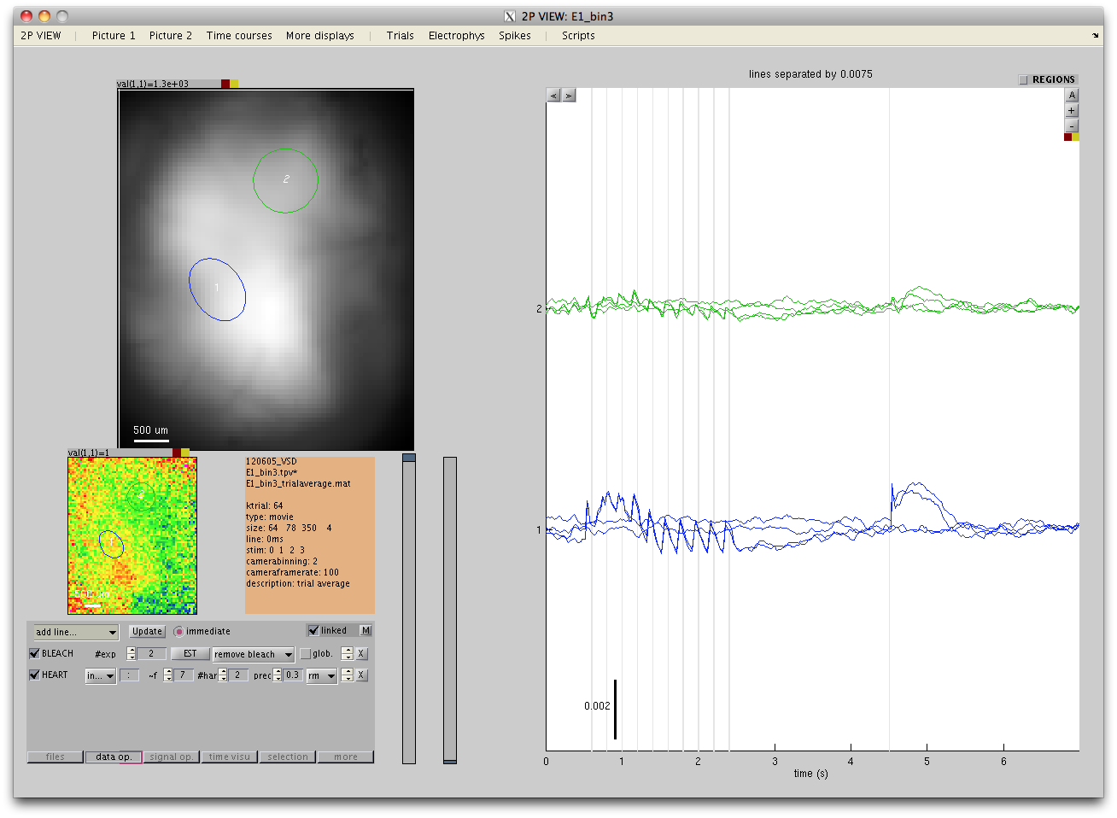
1)c. Operations on movie data
Apply successively a set of operation to the data in the « Data operation panel »

Slide 9
1)d. Extraction of time courses
Select ROIs and get their time courses displayed (see next section « Display of data »)
See « Display of data » section for how to select regions of interest in the Picture displays

Slide 10

1)e. Operations on time courses
Apply successively a set of operation to the signals in the « Signal operation panel »

Slide 11
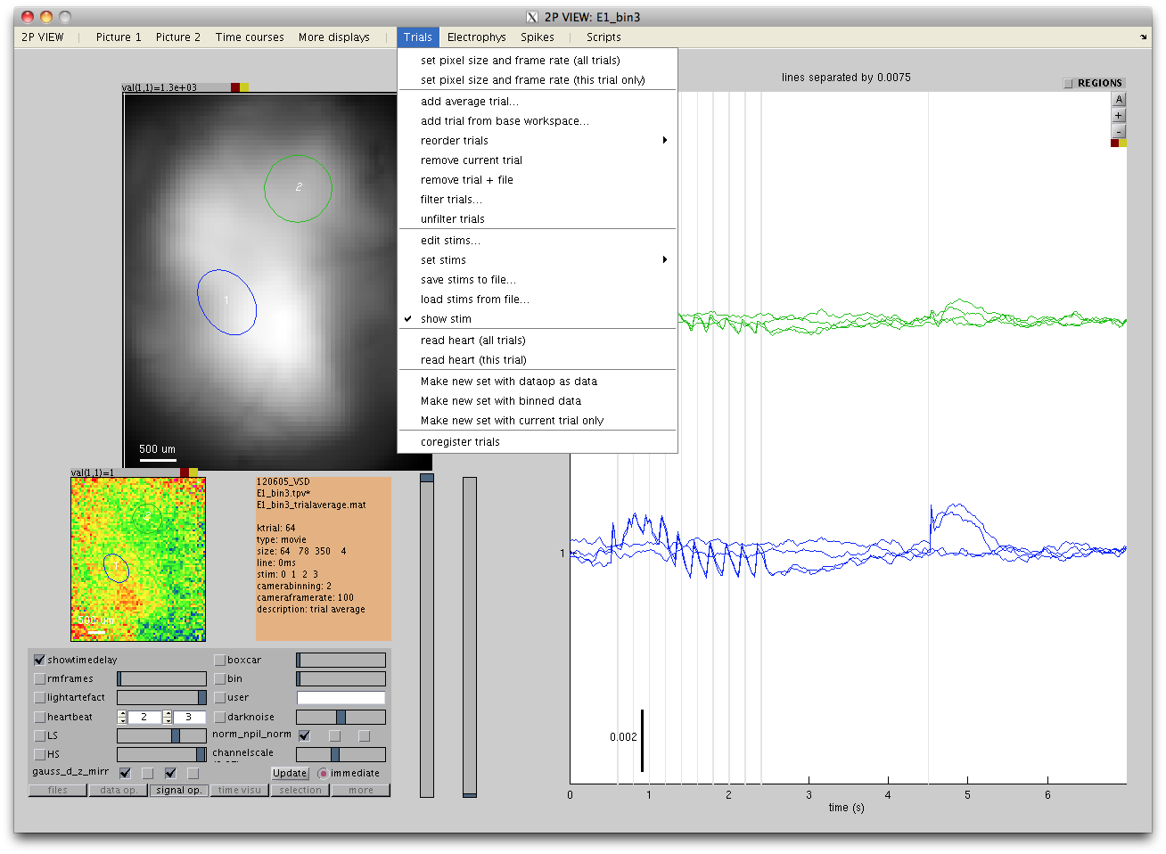
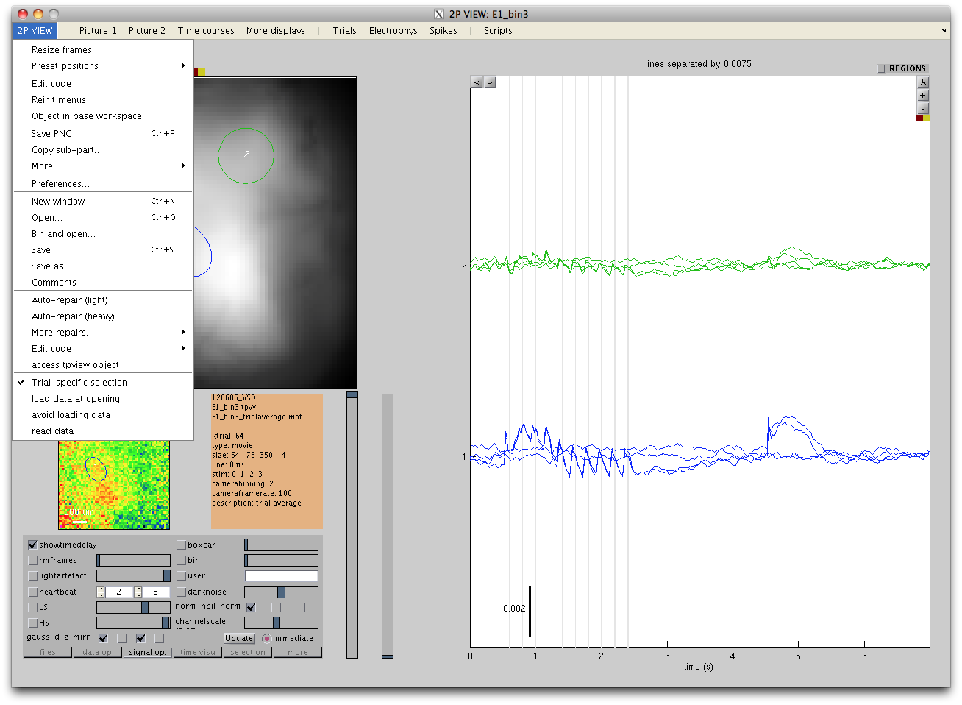
1)f. Save
Save / export / write in a comments file
Save a modified version of the data

Slide 12
2) Visualizing the data
Which displays are available?
What to show in each display?
Picture1 and Picture2
Time Courses
Display options
Picture1 and Picture2
Time Courses
Mouse actions
Principles of region selection
Table of mouse actions

Slide 13
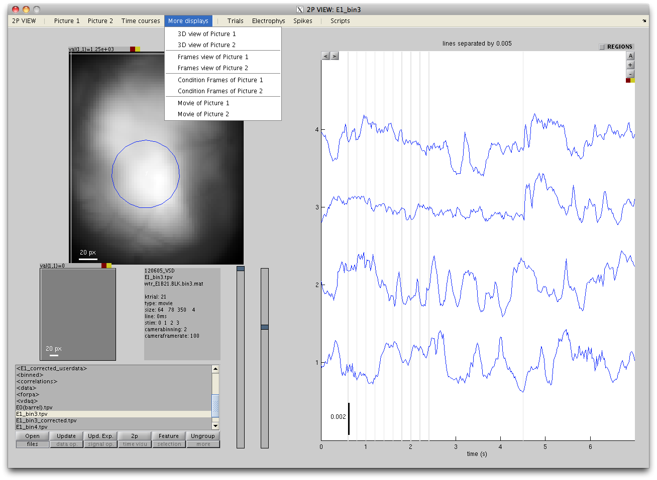
2)a. Which displays are available?
Three default displays: Picture1, Picture2 and Time courses. Each has its own menu.
Additional displays are available from the « More displays » menu.

Slide 14
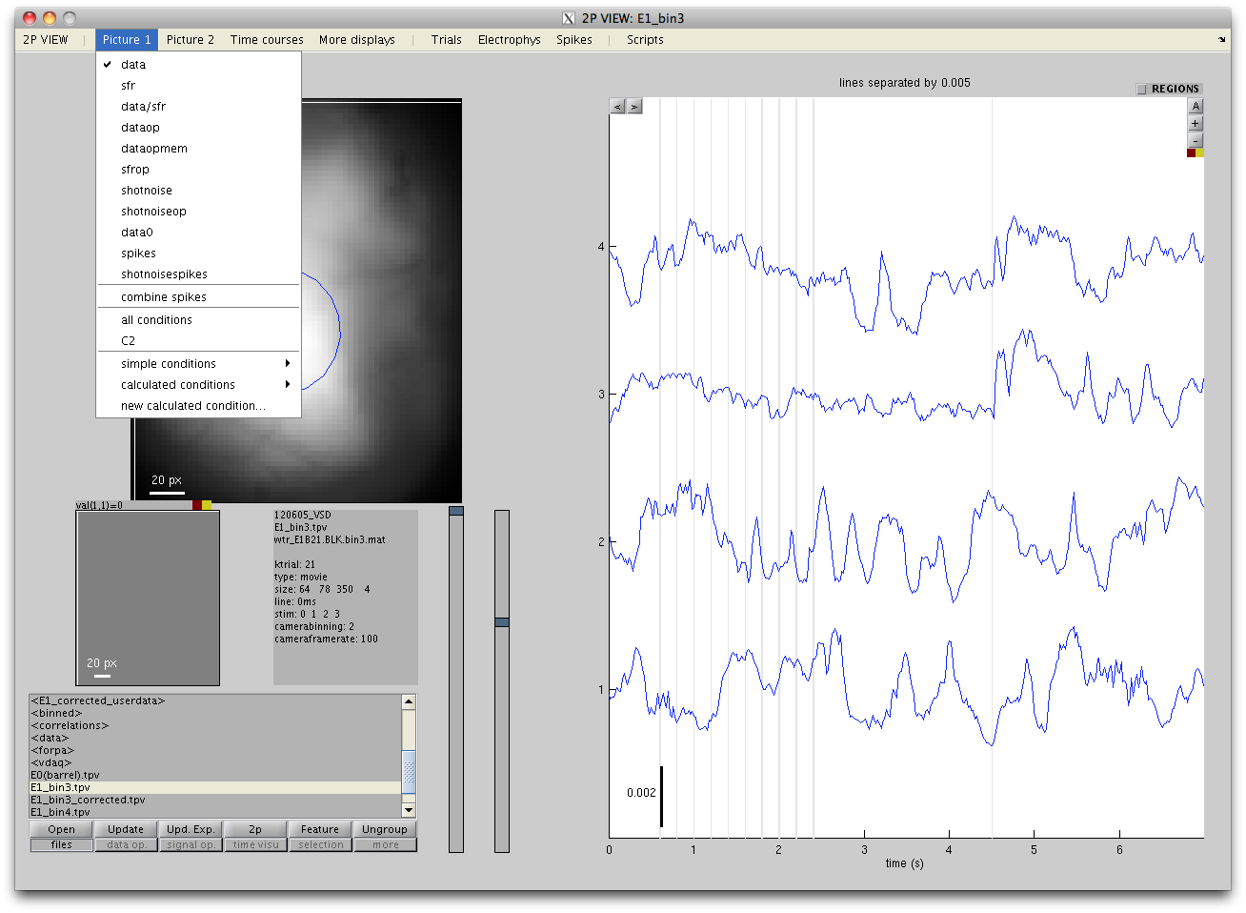
2)b. What to display in Picture1 or Picture2
Which data to display, before or after data operations?
Previously used conditions (multi-condition data only)
Define simple or calculated condition (multi-condition data only)

Slide 15
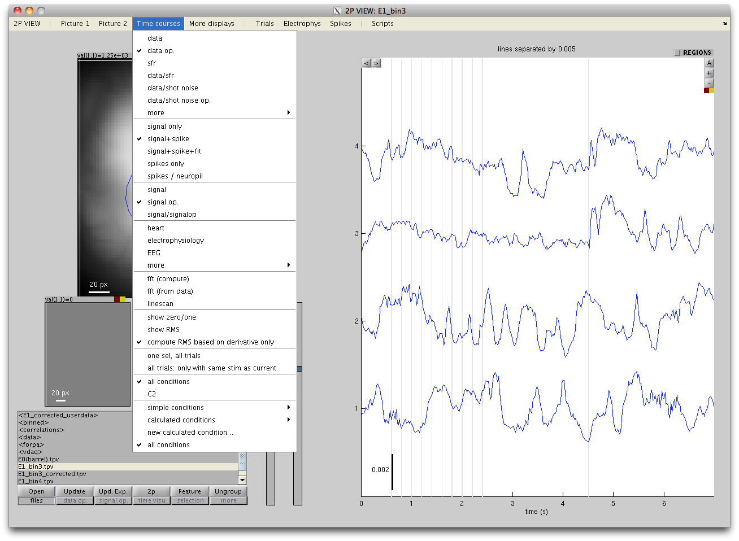
2)b. What to display in Time Courses?
Which data to display, before or after data operations?
Show signals or estimated spikes? (for 2-photon data)
Show signals before or after signal operations?
Data from simultaneous recording
Special displays (Fourier, line scan)
Additional information
Display all ROIs for a single trial, or all trials from a single ROI?
Previously used conditions (multi-condition data only)
Define simple or calculated condition (multi-condition data only)

Slide 16
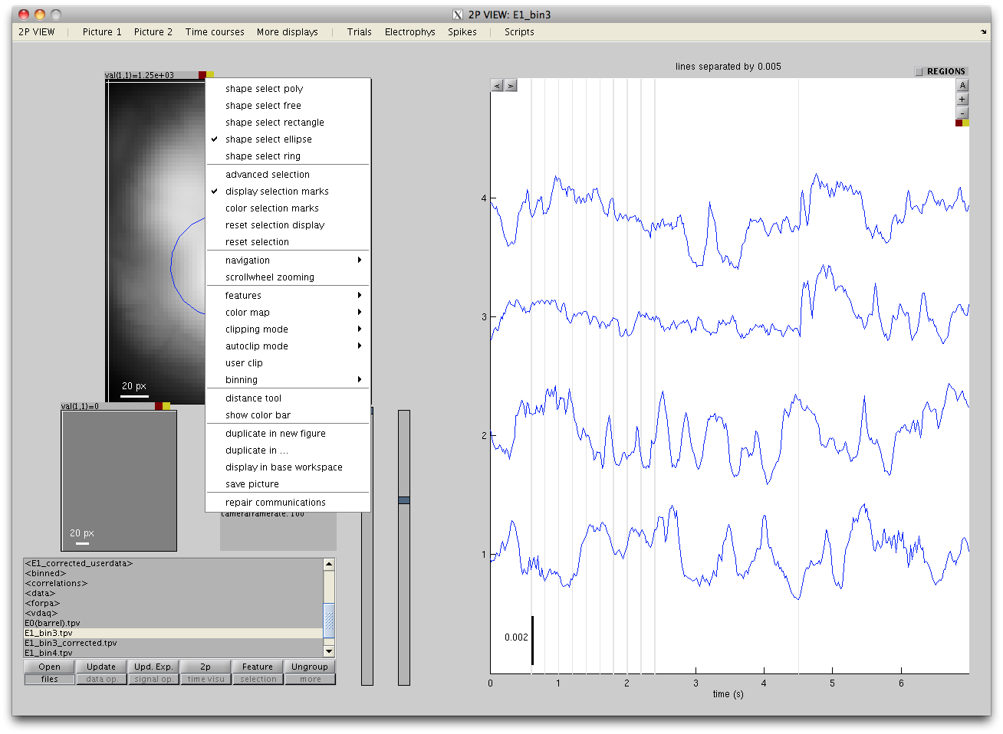
2)c. Display options (Picture1 and Picture2)
Left-click on the red button to adjust the clipping
Right-click on the red button to make a menu of display options appear
Shape of the ROI selection tool
Selection and display of ROIs
Rules for mouse control of zoom and pan
Display options: scale bar, color map, rules for changing the clipping, binning…
Additional tools: distance tool; show the color bar

Slide 17
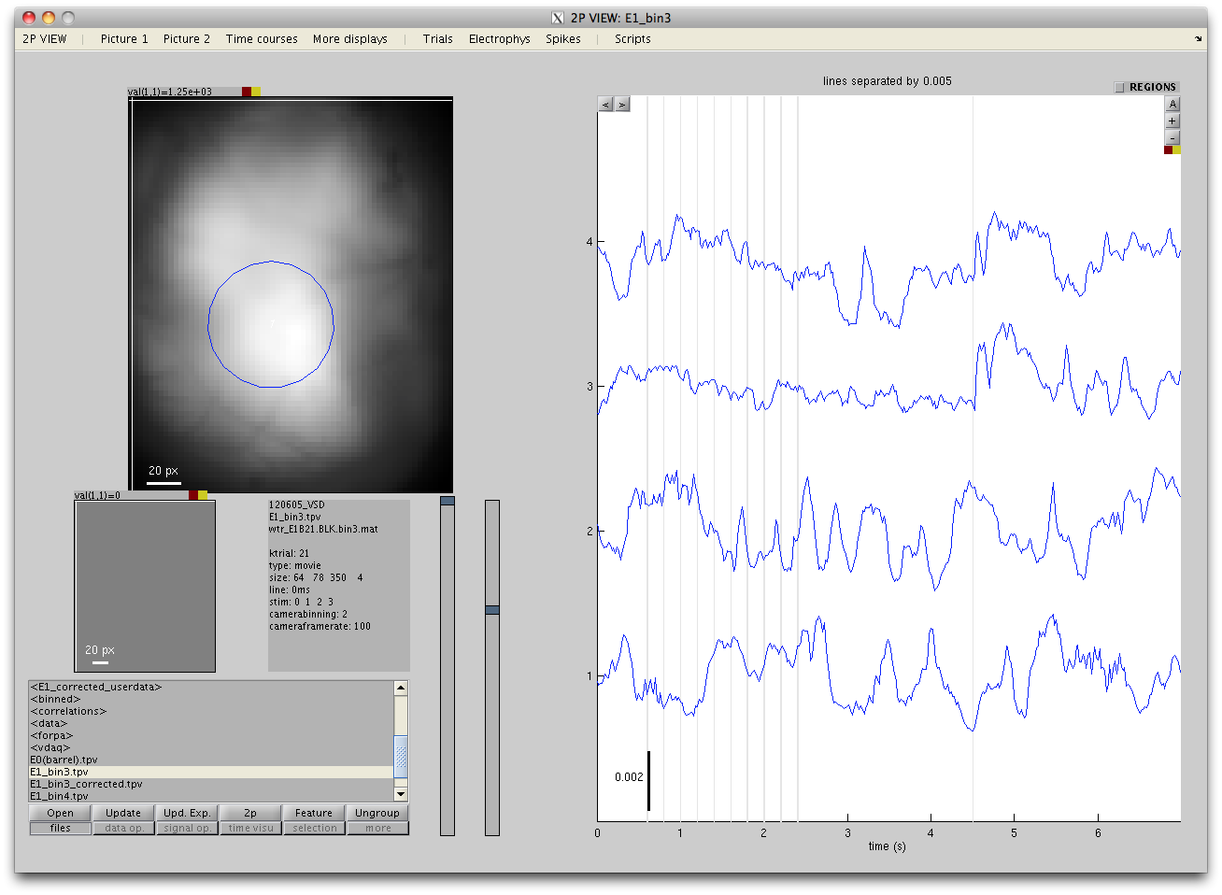
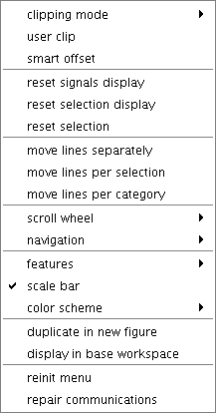
2)c. Display options (Time Courses)
Click on ‘A’ to switch between 3 automatic display modes:
- exact display
- dispatch regions
dispatch conditions
Click on ‘+’ or ‘-‘ to adjust the size.
Right-click on the red button to make a menu of display options appear
Move lines individually or by group?
Rules for mouse control of zoom and pan.
Display options: grid, scale bar, rules for colors…

Slide 18
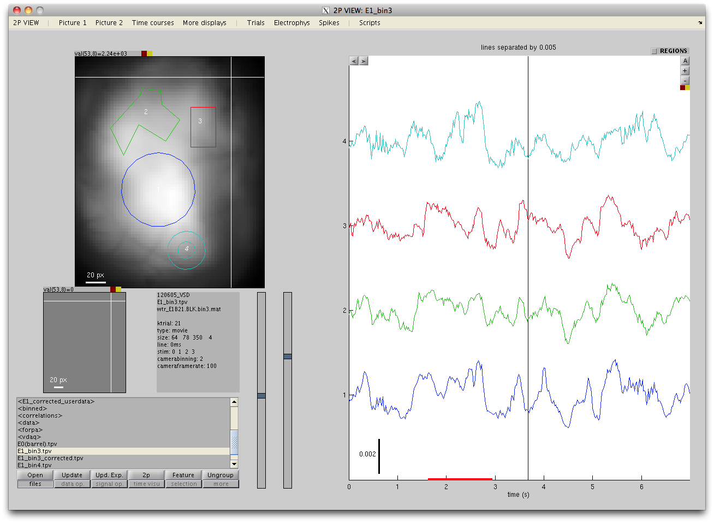
2)d. Principles of region selection
Several regions can be selected in the image, and their time courses are displayed.
If no region is selected, time courses from the single pixel at the location of the white cross are displayed.
Symmetrically, a single temporal region can be selected (shown by a red bar), and frames from this window are averaged in the Picture display.
If no temporal region is selected, a single frame is shown, at the time indicated by the black vertical cursor.

Slide 19
2)d. Mouse actions
Click inside the « gray zone » has special effects
Clicking outside the graph has special effects as well
 |  | PICTURE DISPLAY | TIME COURSES DISPLAY
LEFT BUTTON | point | move cross | move cursor
= navigation | area | zoom / pan | zoom / pan
 | outside or in gray zone | zoom reset | zoom reset
 | double-click | user callback | zoom reset
 | on vertex | move vertex
 | on edge | create new vertex and move it
MIDDLE BUTTON | point | add a point to the current selection | add a point to the current selection
= edit current selection | area | add an area to the current selection | add a segment to the current selection
 | outside or in gray zone | cancel the current selection | cancel selection
 | inside a selection | make this selection the current selection
 | click inside a region and type a number | reorder selections
 | on vertex | move region
 | on edge | move all regions
RIGHT BUTTON | point | create a single-point selection | create a single-point selection
= new selection | area | create a new selection | create a time-window selection
 | inside a selection | hide/show this selection
 | outside or in gray zone | cancel all selection | cancel selection
 | on vertex | remove vertex
SCROLL WHEEL |  | zoom in/out | zoom in/out
=zoom
Some details of the mouse behaviors have to be adjusted from the « red button » menus
Mouse actions marked in gray are active only when the picture « advanced selection mode » is on

Slide 20
3) Other useful tools
The 2Pview menu
Access to the data from the command line

Slide 21
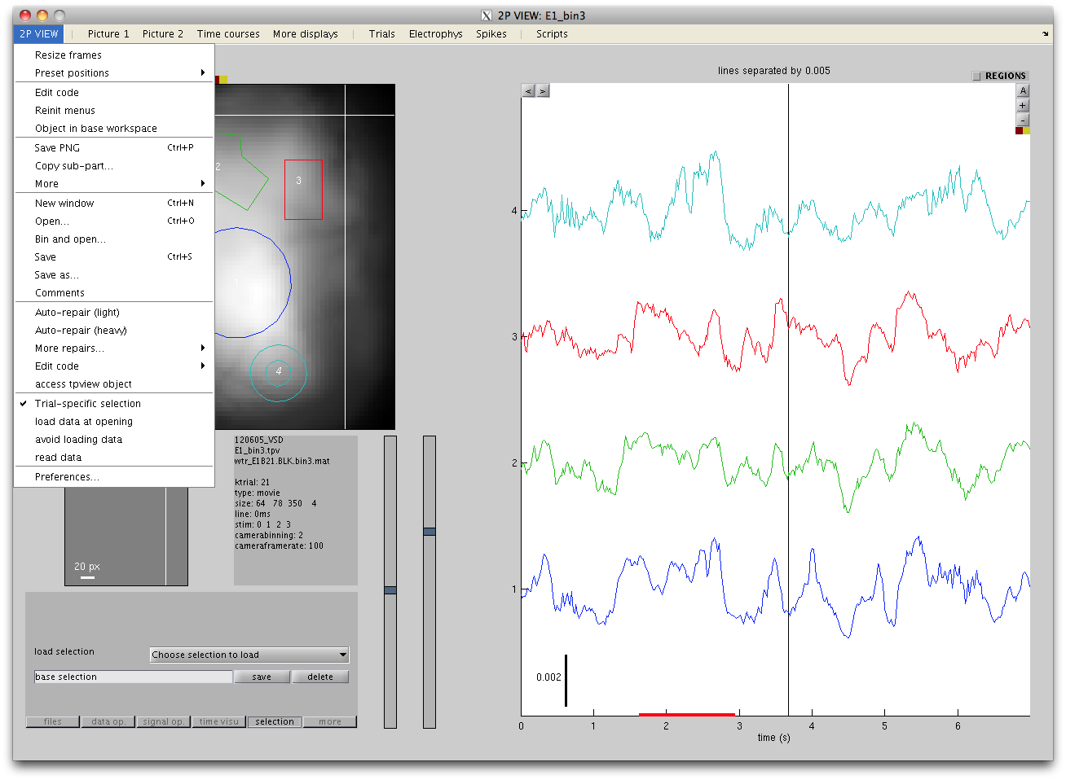
3)a. The « 2Pview » menu
Change the size of the figure and the position of elements
Save a picture
If you are getting in trouble, try « Auto-repair »!!
Load the data from all trials at opening?
Edit preferences

Slide 22
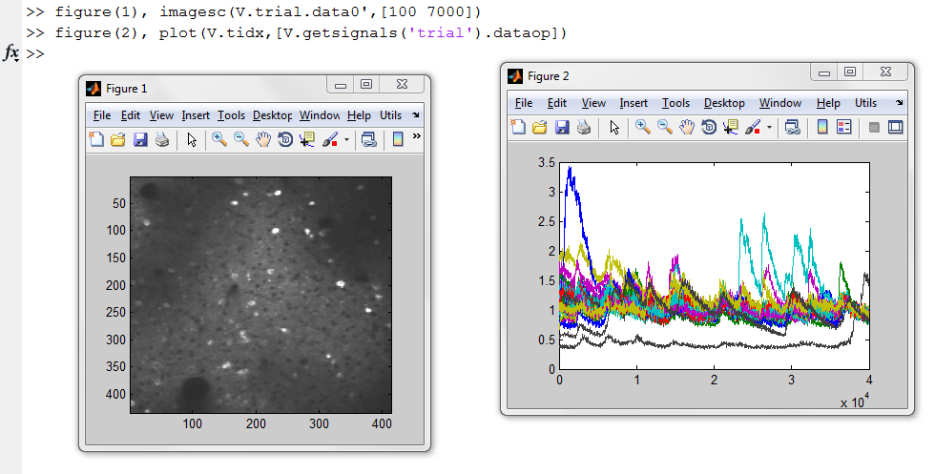
3)b. Access from command line
Main variables of interest:
V.content all the data V.trial current trial
V.content.trials all the trials V.data current trial raw data
V.content.signals all the time courses V.dataop current trial processed data
V. getsignals('current|sel|trial|all') get specific time courses

Slide 23
II. More details
Processing the data
Visualizing the data
Other useful tools

Slide 24
1) Processing the data
Open the data
Header information
Operations on movie data
Extraction of time courses
Operations on time courses
Save
1mm
80ms
STIM

Slide 25
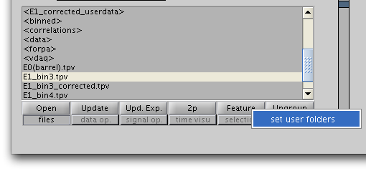
1)a. Open the data
The « file panel »
These two buttons provide the ability to create shortcuts to your two preferred data folders. Right-click on any of them to define these folders.

Slide 26
1)c. Operations on movie data
Apply successively a set of operations to the data in the « Data operation panel ».
The processed data is called “dataop”. To see the result of the operations, the displays should show the variable “dataop” rather than “data”.
Start by pressing “add line…” to select an operation (all different operations are presented in the next slides).
If “immediate” is checked, the data is re-processed and re-displayed immediately after every change in the operation definitions.
To save computation time, uncheck “immediate” and press “Update” only after all operations have been properly defined.
Check/uncheck the box on the left to activate/inactivate each operation.
Press the cross to remove an operation.
Use the arrows to change the order in which the operations are performed.

Slide 27
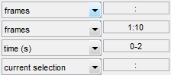
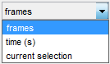
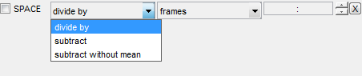
1)c “SPACE” operation : frame normalization
An average frame is calculated from the movie. There are 3 ways to specify which frames to average together:
Define a frame range (e.g. 1:10) , or use “:” to use all frames
Define a time range in seconds (e.g. 0-2)
Use the current temporal selection in the Time Courses display (see section 2d).
This average frame is then used to correct the movie in one of the 3 following ways:
Each frame is divided by the average frame
The average frame is subtracted from each frame
The spatial pattern present in the average frame is subtracted from each frame, but not its mean value (this prevents the processed data to have all frames with their mean over all pixels equal to zero, i.e. the time courses of the data averaged over all pixels is preserved rather than being flattened to zero).

Slide 28
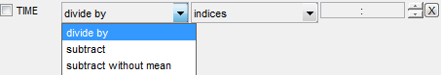
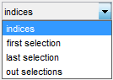
1)c “TIME” operation: time courses normalization
Symmetrically to the “SPACE” operation, an average time courses is first calculated. There are 2 ways to define which pixels to use:
Define a set of pixel indices (e.g. 1:10, indexed as in Matlab) , or use “:” to use all pixels
Use the manually defined ROIs (see section 2d)): use either the first ROI, the last ROI, or the set of pixels that are in none of the ROIs.
This average time courses is used to correct the movie in one of the following ways:
The time courses of each pixel is divided by the average time courses
The average time courses is subtracted to each pixel time courses
The average time courses is subtracted but the mean pixel value over time is preserved (this results in the average movie frame to remain the same rather than being flattened to zero ).

Slide 29
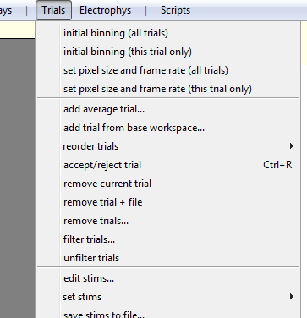
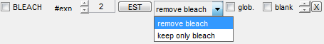
1)c Bleaching correction
Bleaching is modelled as a set of decaying exponentials. The time constants of these exponentials should be estimated once for all at the beginning (‘EST’ button).
Please follow the procedure below.
Time constants should be estimated on the average trial. First compute it in ‘Trials > add average trial…’
2) The algorithm needs to know which conditions are without stimulation: first do ‘Trials > edit stims…’ to set the ‘type’ of the appropriate conditions to ‘blank’.
3) Set the desired number of exponentials to use (typically 2 or 3).
4) Optional: check ‘glob’ if all trials are assumed to share exactly the same bleaching pattern.
Alternatively, check ‘blank’ to make estimations only from the blank trials to avoid the specific patterns of the responses to be fitted by the bleaching exponentials.
5) Make sure that the current trial showing is the average trial and press ‘EST’ to estimate the global parameters of the bleaching.
7) It can be useful to press ‘keep only bleach’ to show the estimated bleach pattern and check that it was properly estimated.
6) Now only activate the correction.

Slide 30
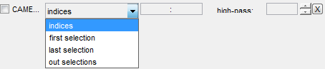
1)c Camera Noise removal
This operation can remove a specific camera noise which is common to all pixels.
Select a region which is rather dark in the image (in such a region the ratio between camera noise and physiological signals is higher) and press ‘last selection’: time courses from this region will be subtracted everywhere to correct the noise.
If the camera noise is known to be high-frequency, set a value for high-passing the time courses, and that way avoid to subtract lower-frequency physiologically meaningful signals.

Slide 31
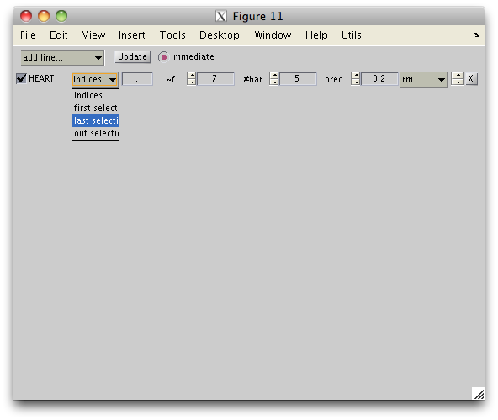
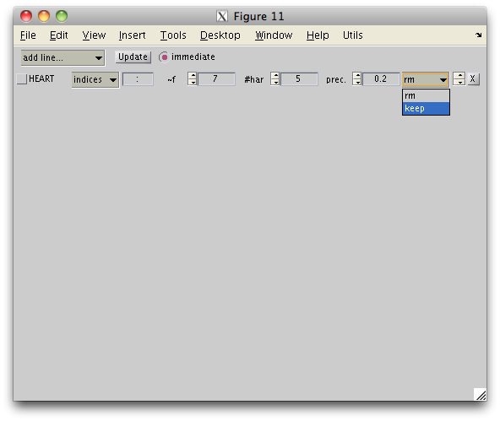
1)c. Heart correction
Removal of heart beat artefact: the underlying method first estimates the phase of the heart pulsation, based on a selected sub-region that is strongly contaminated; then a general linear model estimates the specific shape of heart signals in every pixel.
3) number of harmonics to use (1 would result in a sine wave estimation, more harmonics capture more high frequencies).
4) ‘precision’ parameter: the higher this parameter, the more fluctuations in the frequency are allowed.
5) ‘keep’ keeps only the estimated heart artefact: use this option to double-check that the estimation was accurate. Then select ‘rm’ to remove this artefact from the data.
2) Give an approximative value of the heart frequency. Note that it is necessary that the frame duration has been defined accurately before (here).
1) Draw a region of interest on a blood vessel or any place in the image that has a lot of heart contamination. Then choose option ‘last selection’ to use this region for estimating the phase of the heart pulsation.

Slide 32
1)c Motion correction
This coregisters and resamples the frames in a movie to correct for motion artefacts. This computation can take time.
It is often preferable to create a whole new data set with all trials coregistered together from the ‘Trial > coregister trials’ menu rather than using this option.
The motion can be estimated from a sub-part of the image only. This can increase computation speed, or avoid misestimation due to high noises or high physiological signals in some parts of the image.
Limit to the amplitude of the motion, expressed as a fraction of the frame size
How many frames to take (counted from the first frame) to compute a reference image to which all frames will be aligned.

Slide 33
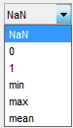
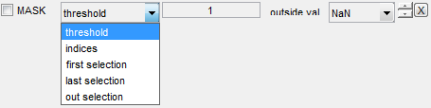
1)c Masking
Keep only a part of the image.
Choose how to select the mask:
All pixels whose average value is above a fixed threshold
Manual selection of pixel indices
Manual selection of a ROI
What value to use outside of the mask:
A fixed value (NaN, 0 or 1)
The minimum, maximum or average value inside the mask.

Slide 34
1)c Spatial and temporal filtering
Spatial low-pass and high-pass cutoff distances expressed in pixels
Temporal low-pass and high-pass cutoff periods expressed in seconds
Options:
d: Use a detrend to minimize edge effects of the temporal filter
z: If a high-pass is applied, keep the mean rather than make the mean zero
ph: (special) get the phase of the signal after temporal filter has been applied
s: ‘sharp cut-off’ - the transfer function of the filter has a sharper cut-off frequency, but this can cause enhanced oscillations near this frequency

Slide 35
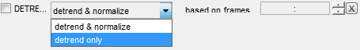
1)c Temporal Detrending
Remove a linear trend in the time courses. It is possible to specify specific frames from which this linear trend is estimated.

Slide 36
1)c Spatial and Temporal binning

Slide 37
1)c Fourier Transform
Check ‘take norm’ to get the norm of the Fourier transform, otherwise the values remain complex (complex values can be visualized in the Image displays but not in the Time Courses displays)

Slide 38
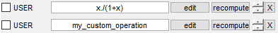
1)c User-defined operation
Users can apply their own functions.
Define a function right inside the control using variable name “x” (1st example below), or write the name of the function to be applied (2nd example).
Press ‘edit’ to edit (or even create) the m-file.
OptImage might not well detect that the m-file content has changed. Press ‘recompute’ to force a function call.

Slide 39
2) Visualizing the data
Which displays are available?
What to show in each display?
How to select conditions
Display options
Mouse actions

Slide 40
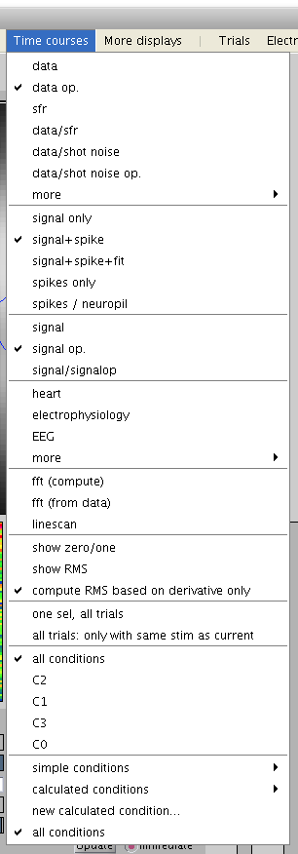
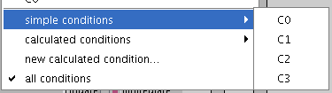
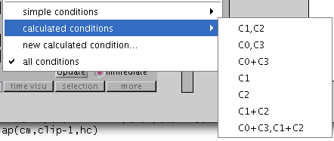
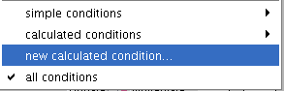
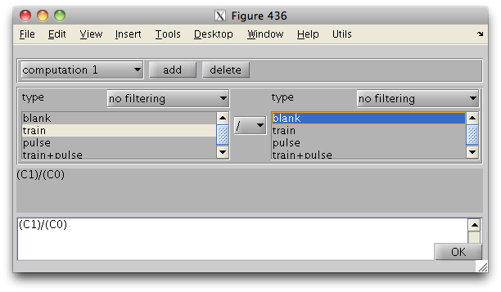
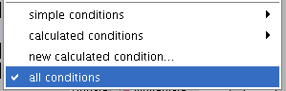
2)b. Select condition(s)
When data has mutiple conditions, it is possible to choose which to display in Picture1, Picture2 or Time Courses. Several options exist:
2) Choose a simple conditions
3) Choose a recent calculated condition
4) Create a new calculated condition: a new window opens that lets you define it
1) Choose one of the recently used conditions
5) Display all simple conditions together

Slide 41
3) Other useful tools
The 2Pview menu
Changing the program size and display
Preferences
Access to the data from the command line

Slide 42
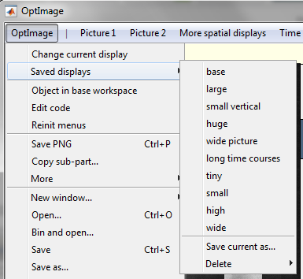
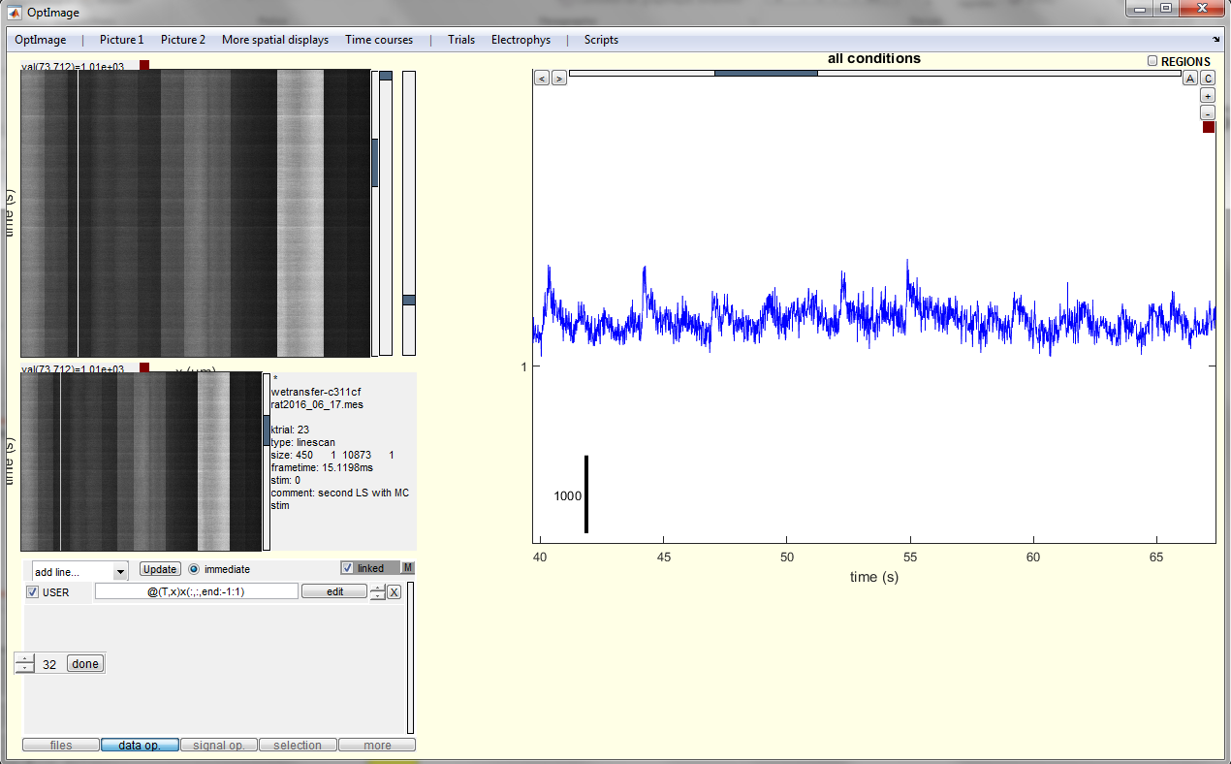
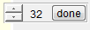
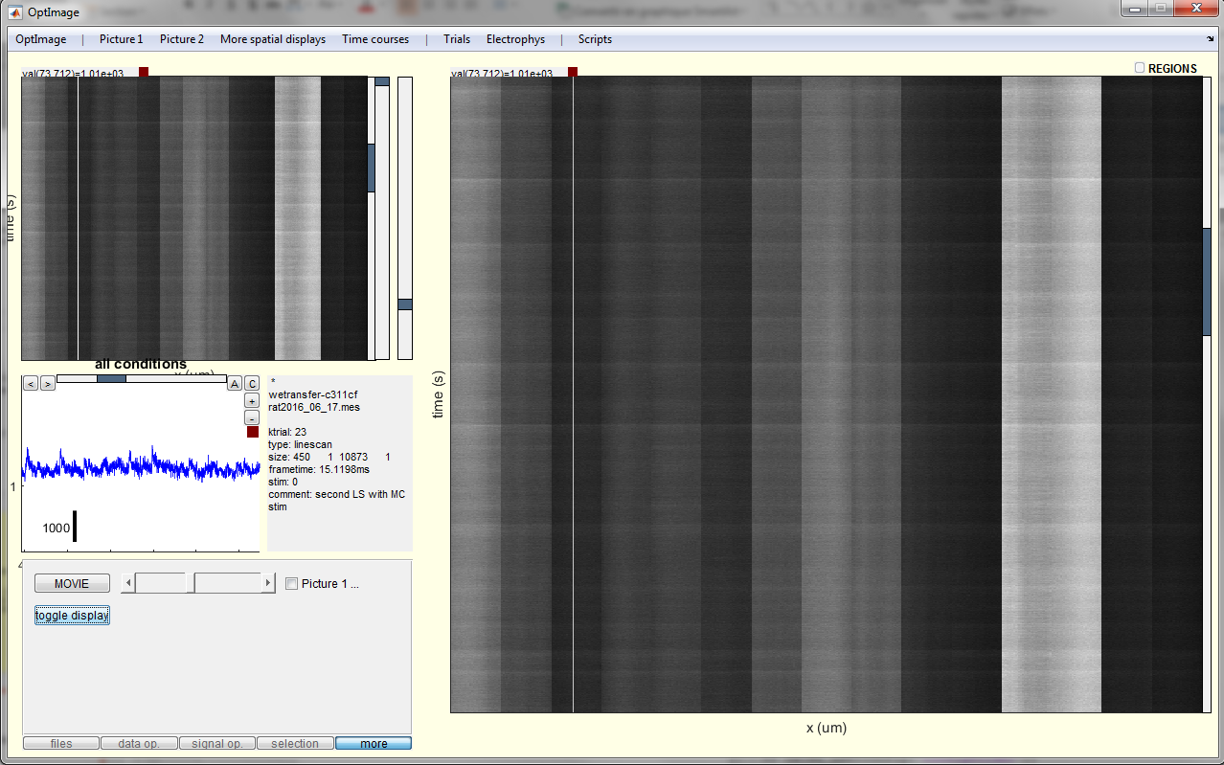

3)a. Changing the program size and display
A number of different configurations are pre-defined.
Select one of them to change the program size and display.
New configurations can be created with ‘Change current display’ and then ‘Save current as…’.
When ‘Change current display’ is pressed, the different elements of the program and the figure itself become resizeable.
For easy alignment of the elements, position coordinates will be automatically rounded to a given number that can be adjusted (here: 32).
move elements sides and corners with mouse left button
drag elements with mouse middle button
round an element coordinates to the set number with a right-button click
Press ‘done’ once finished!
In the ‘more’ panel, button ‘toggle display’ allows to switch image and time courses display when one temporarily needs to see the images larger.
Finally, font sizes can be change in the ‘Preferences’ (see next page).

Slide 43


3)a. Preferences
This section is very important.
Raw data and processed data are stored inside a ‘pool’ whose size is limited. When the pool is filled some data is forgotten and will need to be loaded/computed again when accessed again.
If Matlab runs out of memory, decrease the pool size; if data is permanently forgotten and recomputed, try increasing it.
Preferred float type should normally be set to ‘double’ to avoid numerical errors in computations. However in some circumstances, one can set it to ‘single’ to further save memory.
Change font sizes
If checked, the position of the ROIs can be different for different trials
Parameters to arbitrate between increasing speed and saving memory
If frame time is not set by user, some functions will assume this frame time
Choose between zoom and pan for image and time courses navigation.
Decide whever it is possible to zoom in and out with the scroll wheel.

Slide 44


3)b. Access from command line
Variable ‘V’ contains all the information used by current OptImage window.
The most important field is V.content
If ‘V’ has been cleared, or overwritten by another OptImage window, use this menu option to create it again.
Number of trials
Current trial
Shortcuts to properties of the current trial
Number of ROIs
Shortcut to time courses
Index of current trial
Other fields are for internal use only

Slide 45

‘V.content’ contains all the data.
It is saved in a file with extension ‘tpv’. Load ‘tpv files as follows: load(‘mydata.tpv’,’-MAT’)
All the trials
All the time courses
User can store additional information in this structure.

Slide 46

‘V.content.trials(k)’ contains the information relative to trial k.
File where data is saved: note that the data is not read until it is actually used.
Trial status: ‘n’ormal, ‘r’ejected or ‘s’pecial
Main header information
Header information related to stimulation
Processing applied to the data
Average frame of the raw data
Raw data
Processed data

Slide 47


‘V.content.signal.x(k,i)’ contains the information relative to time courses for trial k and region of interest i.
Processing applied to the signals
Coordinates of the region of interest
Vector of time instants
Time courses before signal processing
Time courses of secondary data before signal processing
Time courses after signal processing
Time courses of secondary data after signal processing
Signals can be accessed also using the following method:
V.getsignals(ktrials,iregions), or V.getsignals(‘all’), V.getsignals(‘trial’), V.getsignals(‘sel’), V.getsignals(‘current’)

